Slide 1
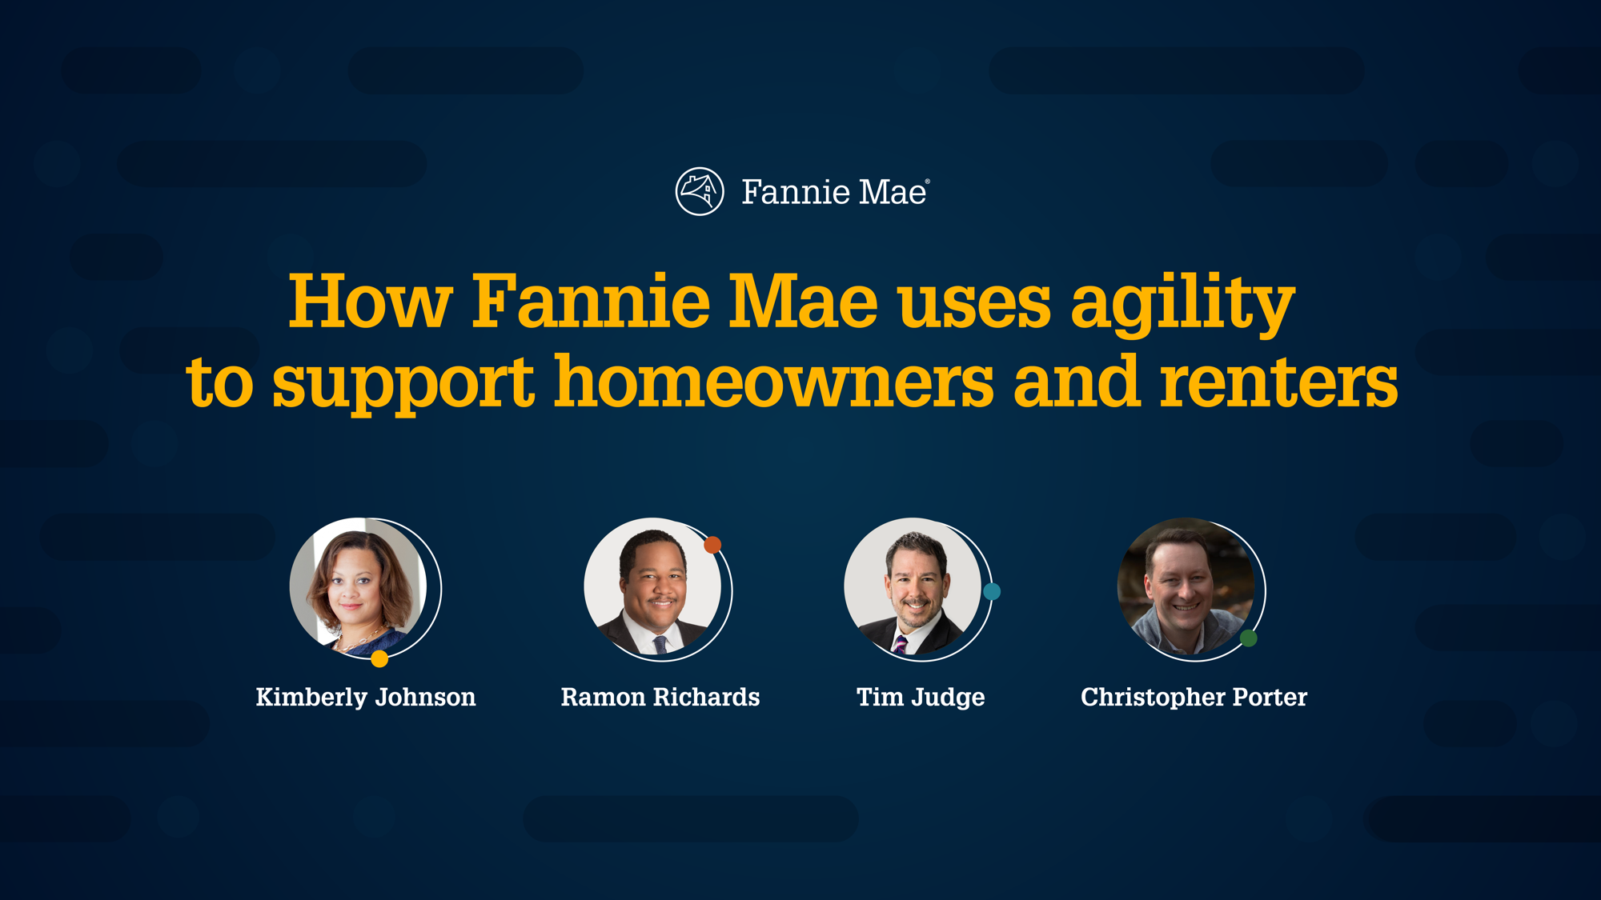
EVP & Chief Operating Officer
SVP, Integrated Technology Solutions
VP, Climate Impact
SVP & Chief Information Security Officer

Slide 2
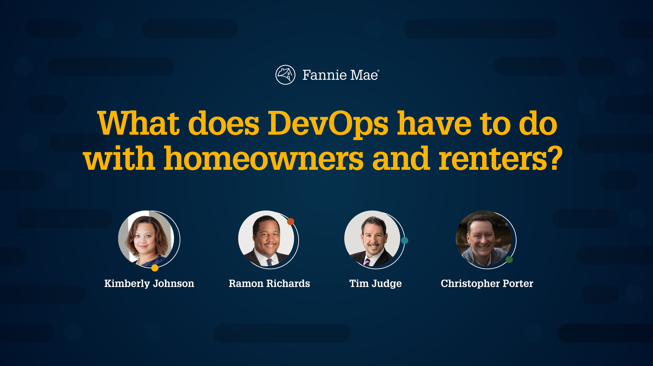
EVP & Chief Operating Officer
SVP, Integrated Technology Solutions
VP, Climate Impact
SVP & Chief Information Security Officer

Slide 3

single-family homes is purchased or refinanced with Fannie Mae.
The integration of business and technology is critical for success.

Slide 4
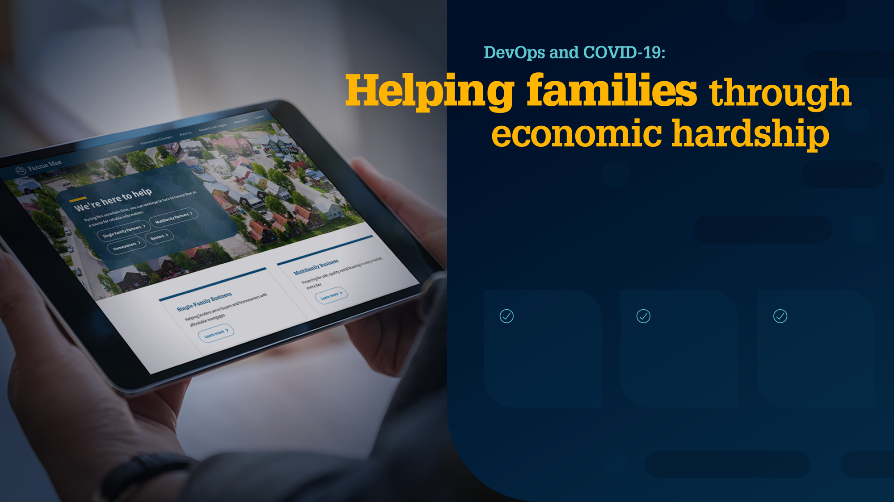
Challenge:
Deliver new solutions quickly to keep people in their homes.
DevOps helps to:
Reduce testing timeline significantly.
Enhance quality and accelerate time to market.
Collaborate proactively to expedite decision making.

Slide 5
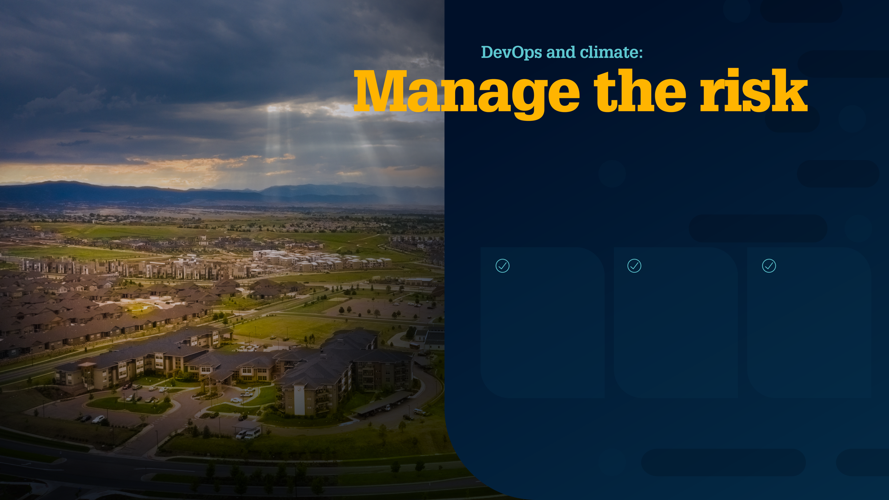
Challenge:
Prepare for a future of potential unknowns.
DevOps helps to:
Enable businesses to consistently deliver value by shifting left.
Separate transformational work from daily delivery.
Encourage business leaders and technologists to embrace change to manage risks.

Slide 6
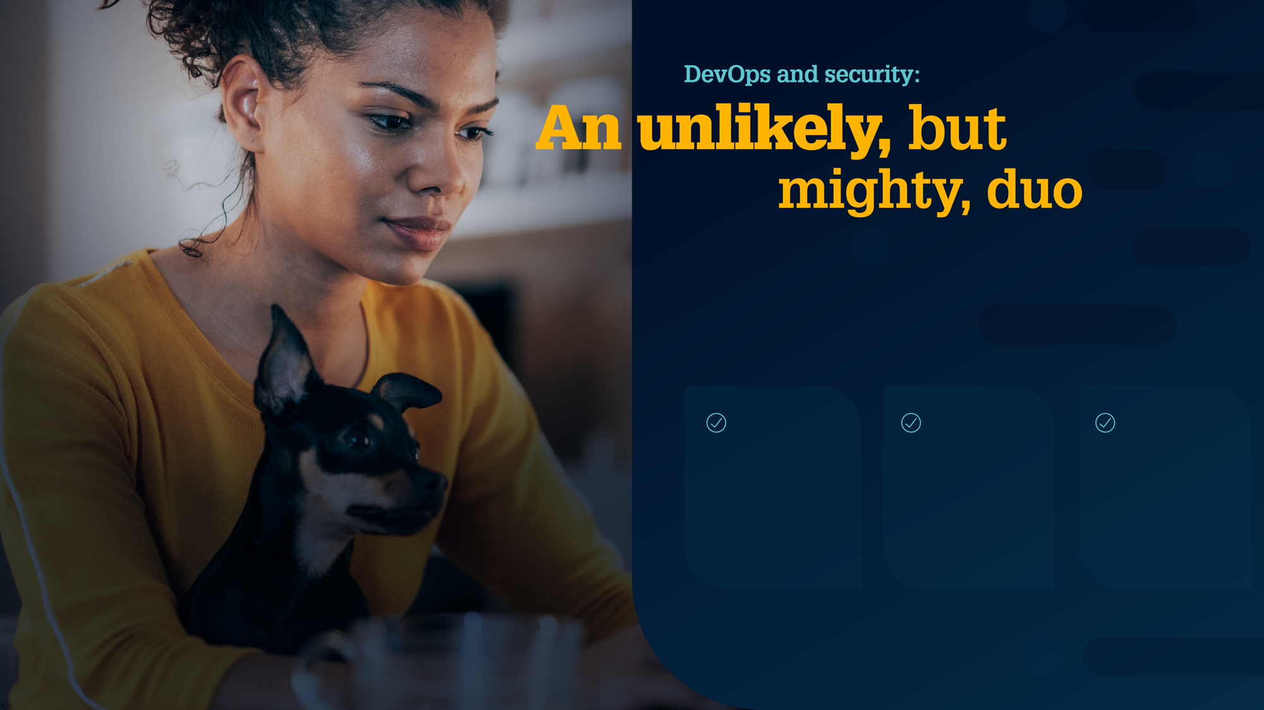
Challenge:
Ensuring security strengthens everything we do.
DevOps helps to:
Learn from chaos engineering to improve security.
Put security in the Pipeline.
Weave security transparently into the fabric of everything we do.

Slide 7
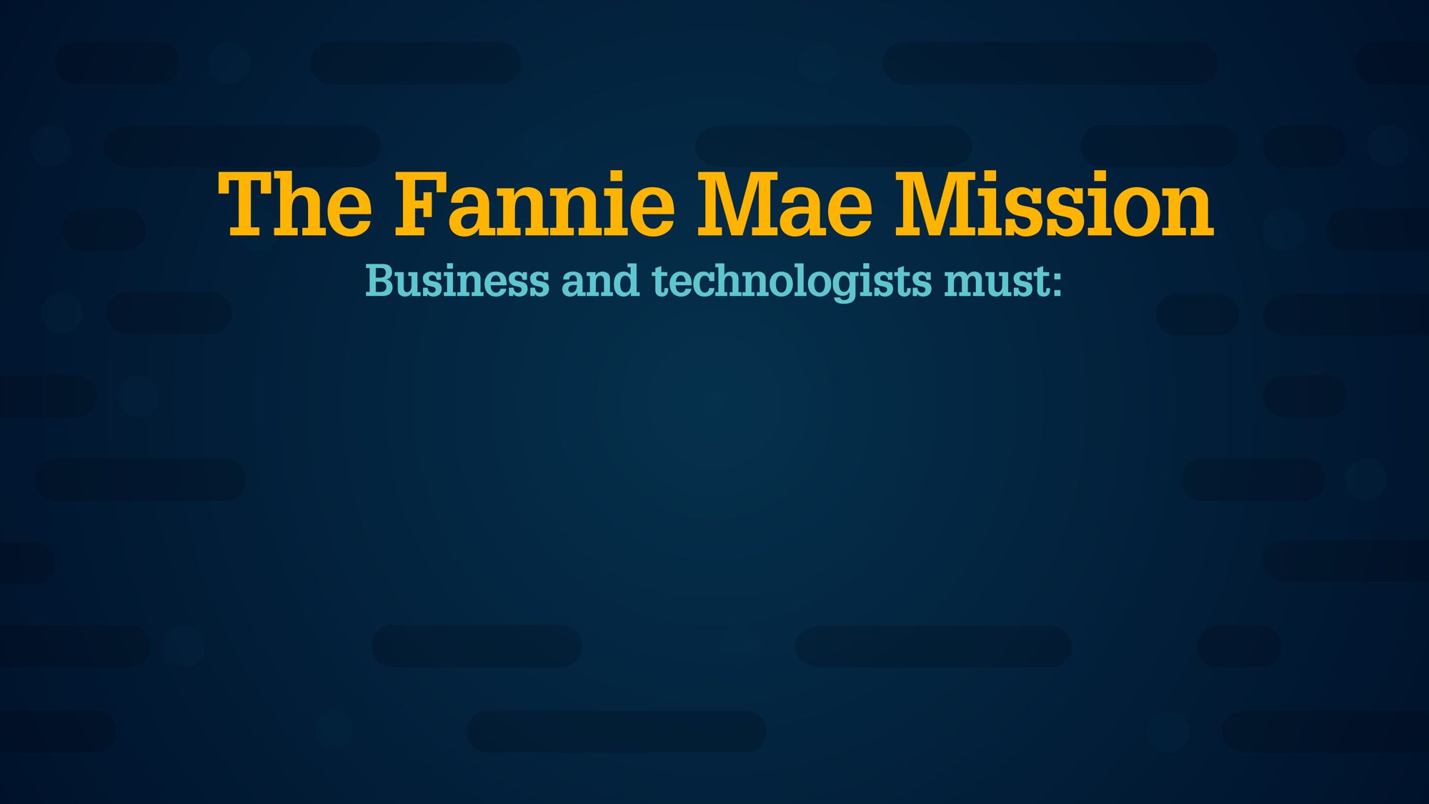



Make back-end software seamless for a faster, more reliable experience.
Be agile in providing solutions for homeowners and renters.
Make speed safe with security at the outset.

Slide 9
Alternate options
Alternate photography options for diversity in age, race, and gender and layout.

Slide 10

single-family homes is purchased or refinanced with Fannie Mae.
The integration of business and technology is critical for success.

Slide 11

Challenge:
Prepare for a future of potential unknowns.
DevOps helps to:
Enable businesses to consistently deliver value by shifting left.
Separate transformational work from daily delivery.
Encourage business leaders and technologists to embrace change to manage risks.

Slide 12




Make back-end software seamless for a faster, more reliable experience.
Be agile in providing solutions for homeowners and renters.
Make speed safe with security at the outset.

